Slide 1

PROJECT TITLE
KEY LOGEER IN PYTHON
PRESENTED BY:
SIVAKUMAR S
INFORMATION TECHNOLOGY
ANJALAI AMMAL MAHALINGAM ENGINEERING COLLEGE

Slide 2
OUTLINE
Problem Statement
Proposed System/Solution
System Development Approach
Algorithm & Deployment
Result (Output Image)
Conclusion
Future Scope
References

Slide 3
PROBLEM STATEMENT
Develop a key logger application in Python that captures keystrokes from the keyboard input of a user and records them into a log file. The key logger should run in the background without the user's explicit knowledge. It should be able to capture keystrokes from any application or window the user interacts with.

Slide 4
PROPOSED SOLUTION
Basic Key logger
Create a simple key logger that captures all keystrokes (including special keys) and saves them to a log file. Use the pynput library to listen for key events. Save the captured keys to a text file (e.g., “log.txt”).Implement graceful exit
(e.g., stop logging when the Escape key is pressed)
Advanced Features
Add timestamping to each logged keystroke. Encrypt the log file for security. Implement remote reporting (send logs
to a server or email) for monitoring purposes.
Ethical Considerations
Always use key loggers responsibly and legally. Obtain proper consent before deploying a key logger
Time stamping
Enhance your key logger by adding timestamps to each logged key stroke. Use the date time module to record the exact
time when a key was pressed. Include the timestamp in the log file alongside the corresponding key.
Encryption
Consider encrypting the log file to protect sensitive information. Use encryption libraries (e.g., cryptography) to
secure the log data. Encrypt the log content before writing it to the file and decrypt it when needed.

Slide 5
Slide 27
SYSTEM APPROACH
Objective: The primary goal of our key logger is to capture keystrokes made by the user and log them for further analysis or monitoring.
KEY LISTENER:
We’ll use the pynput library to listen for key events (both key presses and releases).
The key listener will run in the background, capturing keystrokes without disrupting the user’s normal activities.
DATA STORAGE:
We’ll save the captured keystrokes to a log file (e.g. log.txt).
Each key press will be recorded along with a timestamp (optional).
USER INTERFACE(Optional):
We can create a simple command-line interface (CLI) to start and stop the key logger.

Slide 6
ALGORITHM AND DEPLOYMENT
Key Listener Setup:
Initialize a key listener using the chosen library (e.g., pynput for Windows, pyxhook for Linux).
Define callback functions for key presses (e.g., on_press) and key releases (e.g., on_release).
Capture Keystrokes:
In the on_press callback:
Capture the pressed key (ASCII value or character).
Handle special keys (e.g., Enter, Space, Backspace).
Append the key to a buffer or log.
Write to Log File:
Implement the write_file function.

Slide 7
DEPLOYMENT APPROACH
Local Deployment:
Run the Python script on the local machine where you want to capture keystrokes.
Ensure that the script runs in the background (e.g., minimize the console window).
The keylogger will save all keystrokes to the specified log file.
Executable Creation:
Convert the Python script into an executable (e.g., using tools like pyinstaller or cx_Freeze).
Distribute the executable to target machines.
Users can run the executable discreetly to start the keylogger.
Ethical Considerations:
Always use keyloggers responsibly and legally.
Obtain proper consent before deploying a keylogger.
Educate users about the purpose and scope of monitoring.

Slide 8
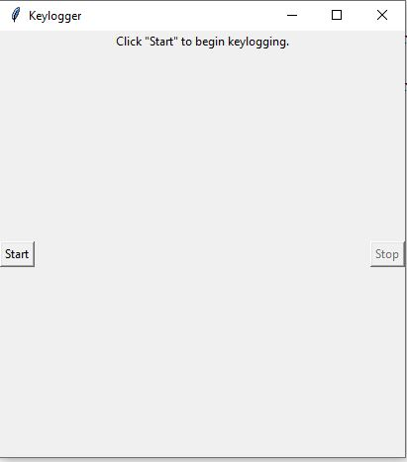
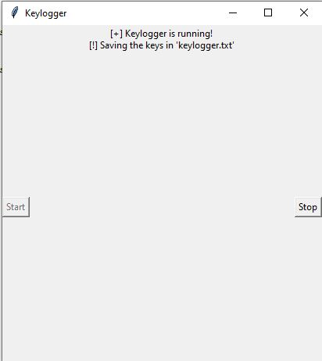
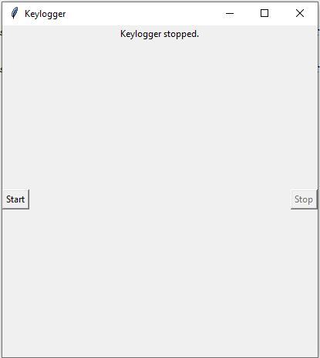
RESULTS
The keylogger runs and saves all keyLogs to “c:\output.txt”.
TO START KEY LOGGER
KEY LOGGER RUNNING
KEY LOGGER TERMINATED

Slide 9
CONCLUSION CONCLUSION
our Python key logger project aims to capture keystrokes on a computer system. It can be used for security, monitoring, research, or educational purposes.
In conclusion, the key logger project serves as a valuable learning experience, providing insights into cybersecurity, ethical considerations, and the responsible development of monitoring tools.By approaching key logger development with a commitment to ethics and integrity,
we can harness the potential of such tools while safe guarding privacy and respecting individual rights.

Slide 10
FUTURE SCOPE
Security and Troubleshooting:
Key loggers can continue to play a crucial role in troubleshooting technical problems with computers and business networks. They help identify issues related to keyboard input, system behavior, and software conflicts. Key loggers can be integrated into security systems to detect unauthorized access attempts or suspicious activities. By monitoring keystrokes, they can raise alerts when unusual patterns are detected.
User Monitoring and Productivity:
Organizations can use key loggers to monitor employee productivity, track work-related activities, and ensure compliance with company policies.
Key loggers can help parents keep an eye on their children’s online activities, ensuring their safety and responsible internet usage.
Cross-Platform Key loggers:
Extend key loggers to work on multiple operating systems (Windows, Linux, macOS, Android, iOS).
Cloud Integration: Store logs securely in the cloud, allowing remote access and analysis.
Machine Learning: Implement machine learning algorithms to detect anomalies or predict user behavior based on keystrokes.

Slide 11
REFERENCES
GeeksforGeeks provides a detailed tutorial on creating a keylogger using Python. It covers capturing keystrokes, saving logs, and handling security considerations.
Design a Key logger in Python – GeeksforGeeks.
Wikipedia’s article on keystroke logging provides an overview of keyloggers, their history, and various applications.
Keystroke Logging – Wikipedia.

Slide 12
THANK YOU

